Slide 1
NYC AirBnb
Predicting Price
Photo by Andre Benz on Unsplash

Slide 2
Exploratory Data Analysis Dataset codebook
id: listing ID
name: name of the listing
host_id: host ID
host_name: name of the host
neighbourhood_group: location
neighbourhood: area
latitude: latitude coordinates
longitude: longitude coordinates
room_type: listing space type
price: price in dollars
minimum_nights: amount of nights minimum
number_of_reviews: number of reviews
last_review: latest review
reviews_per_month: number of reviews per month
calculated_host_listings_count: amount of listing per host
availability_365: number of days when listing is available for booking

Slide 3
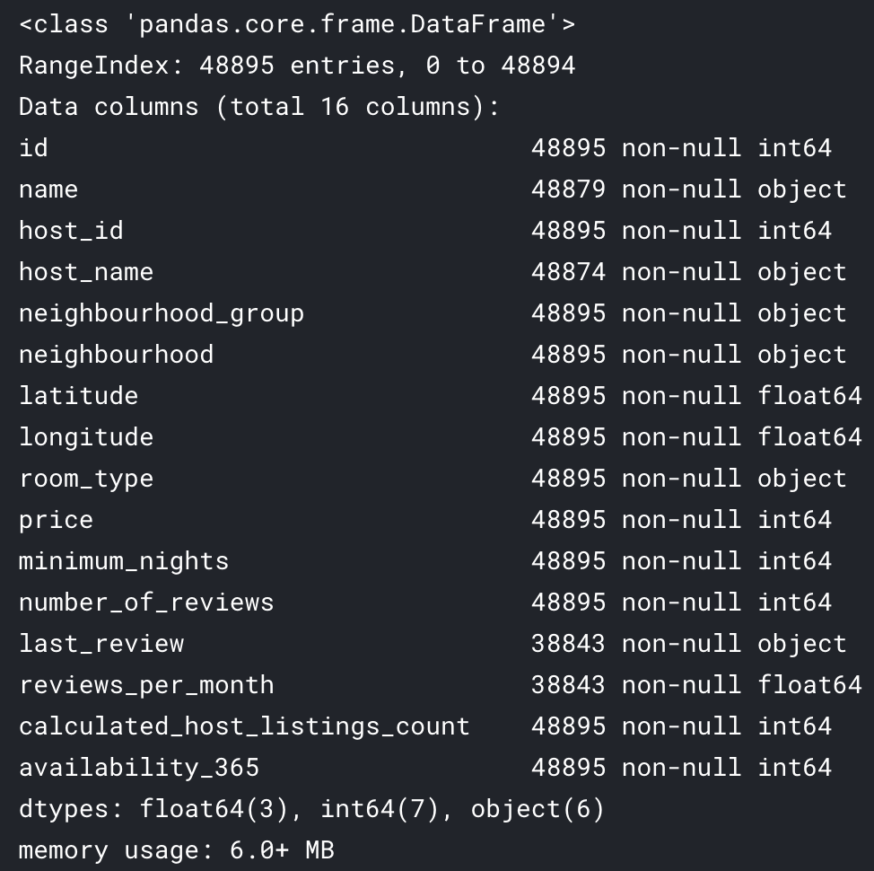
Exploratory Data Analysis Visualize the shape of the distribution

Slide 4
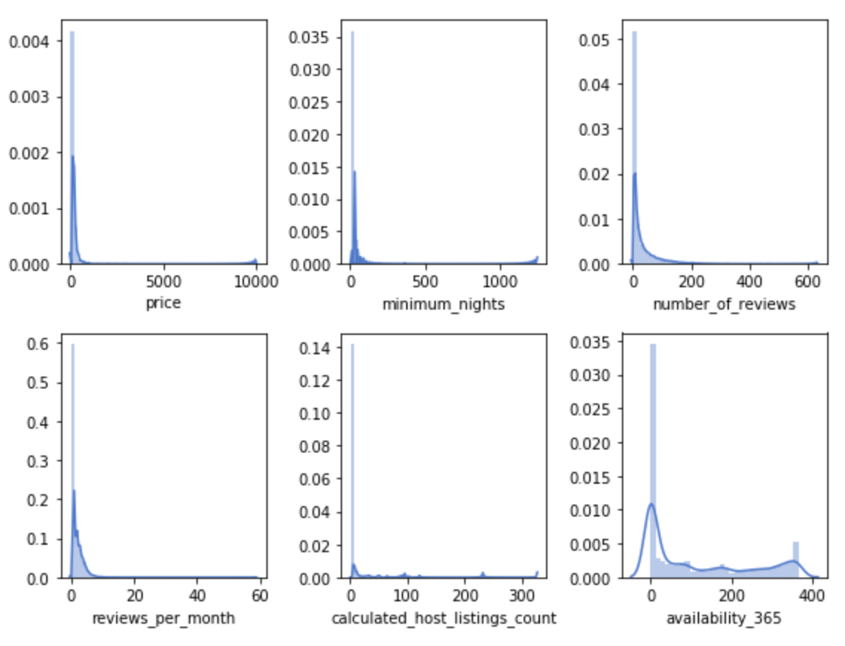
Exploratory Data Analysis Visualize the shape of continuous data

Slide 5
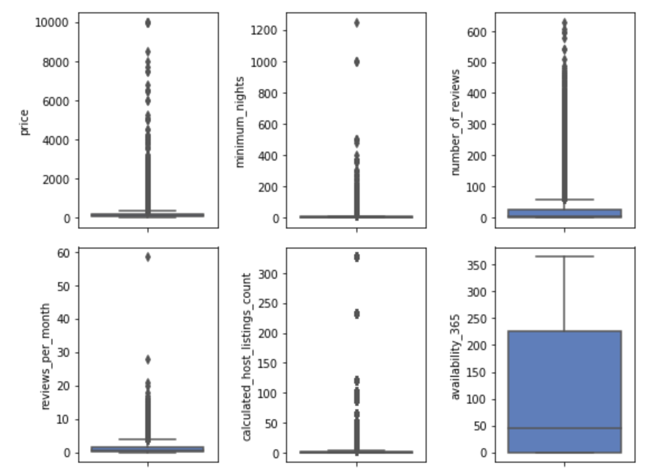
Exploratory Data Analysis Visualize the shape of continuous data

Slide 6
Exploratory Data Analysis Visualize the shape of continuous data
Most features are left-skewed.
I used a log transform before building the model.

Slide 7
Exploratory Data Analysis Visualize the categorical features

Slide 8
Data Visualization Correlation between features

Slide 9
Data Visualization Neighbourhood group and room type

Slide 10
Data Visualization Neighbourhood impact on price

Slide 11
Data Visualization Neighbourhood impact on price
For the rest of the analysis, the dataset will be split between lows and higher prices

Slide 12
Data Visualization Room types impact on price

Slide 13
Data Visualization Reviews number impact on price

Slide 14
Data Visualization Reviews number impact on price

Slide 15
Model Prepare the datset
Log10 transform left skewed features
Split the dataset into low and high price
Evaluate the model

Slide 16
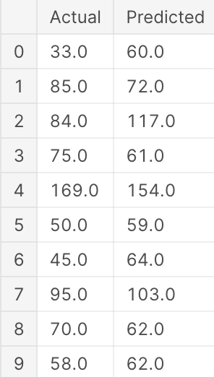
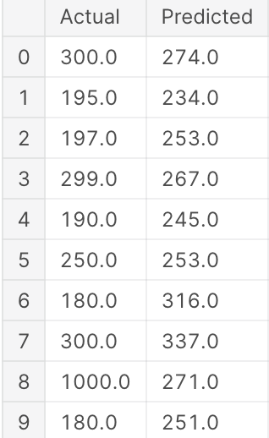
Model Multiple linear regression
Low price dataset
High price dataset
Price mean: 1.92
Price std: 0.2
RMSE: 0.14
R2 score train: 0.54
R2 score test: 0.52
Price mean: 2.45
Price std: 0.2
RMSE: 0.2
R2 score train: 0.09
R2 score test: 0.05

Slide 17
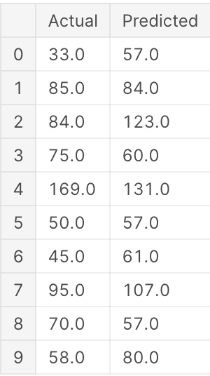
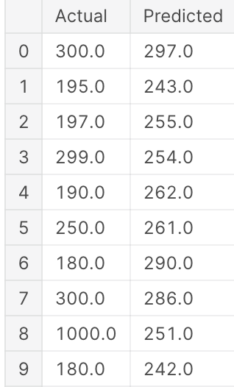
Model Random forest regression
Low price dataset
High price dataset
Price mean: 1.92
Price std: 0.2
RMSE: 0.13
R2 score train: 0.62
R2 score test: 0.55
Price mean: 2.45
Price std: 0.2
RMSE: 0.19
R2 score train: 0.29
R2 score test: 0.16

